Slide 1
SPI(Serial Pheriphiral Interface)

Slide 2
Introduction
SPI is a common communication protocol used by many different devices.
One unique benefit of SPI is the fact that data can be transferred without interruption.
Any number of bits can be sent or received in a continuous stream.
With I2C and UART, data is sent in packets, limited to a specific number of bits.
Start and stop conditions define the beginning and end of each packet, so the data is interrupted during transmission.

Slide 3
Devices communicating via SPI are in a master-slave relationship.
The master is the controlling device (usually a microcontroller), while the slave (usually a sensor, display, or memory chip) takes instruction from the master.
The simplest configuration of SPI is a single master, single slave system, but one master can control more than one slave

Slide 4
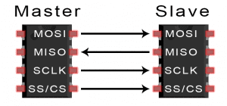
MOSI (Master Output/Slave Input) – Line for the master to send data to the slave.
MISO (Master Input/Slave Output) – Line for the slave to send data to the master.
SCLK (Clock) – Line for the clock signal.
SS/CS (Slave Select/Chip Select) – Line for the master to select which slave to send data to.

Slide 5
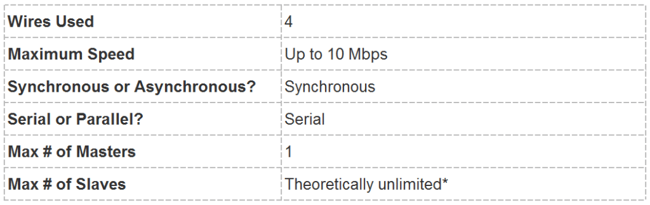

Slide 6
In practice, the number of slaves is limited by the load capacitance of the system, which reduces the ability of the master to accurately switch between voltage levels.

Slide 7
Working
The clock signal synchronizes the output of data bits from the master to the sampling of bits by the slave.
One bit of data is transferred in each clock cycle, so the speed of data transfer is determined by the frequency of the clock signal.
SPI communication is always initiated by the master since the master configures and generates the clock signal.

Slide 8
Any communication protocol where devices share a clock signal is known as synchronous.
SPI is a synchronous communication protocol.
There are also asynchronous methods that don’t use a clock signal.
For example, in UART communication, both sides are set to a pre-configured baud rate that dictates the speed and timing of data transmission.

Slide 9
The clock signal in SPI can be modified using the properties of clock polarity and clock phase.
These two properties work together to define when the bits are output and when they are sampled.
Clock polarity can be set by the master to allow for bits to be output and sampled on either the rising or falling edge of the clock cycle.
Clock phase can be set for output and sampling to occur on either the first edge or second edge of the clock cycle, regardless of whether it is rising or falling.

Slide 10
SLAVE SELECT
The master can choose which slave it wants to talk to by setting the slave’s CS/SS line to a low voltage level.
In the idle, non-transmitting state, the slave select line is kept at a high voltage level.
Multiple CS/SS pins may be available on the master, which allows for multiple slaves to be wired in parallel.
If only one CS/SS pin is present, multiple slaves can be wired to the master by daisy-chaining.

Slide 11
MULTIPLE SLAVES
SPI can be set up to operate with a single master and a single slave, and it can be set up with multiple slaves controlled by a single master.
There are two ways to connect multiple slaves to the master.

Slide 12
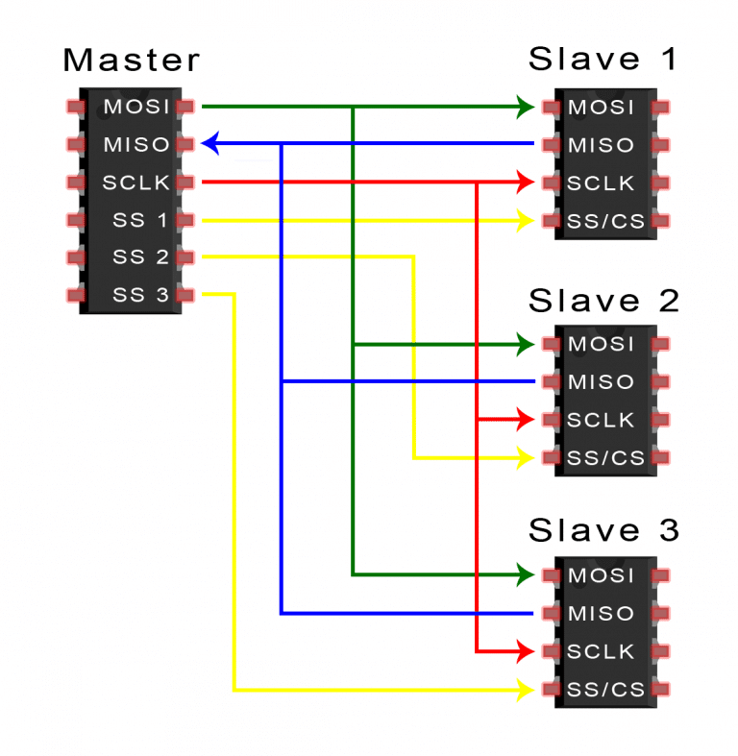
If the master has multiple slave select pins, the slaves can be wired in parallel.

Slide 13
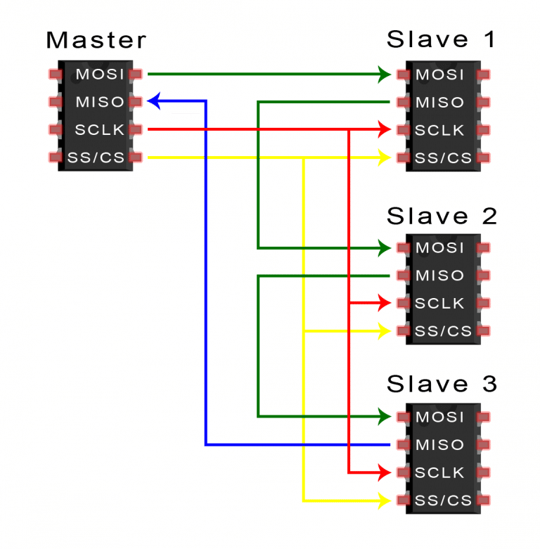
If only one slave select pin is available, the slaves can be daisy-chained .

Slide 14
MOSI AND MISO
The master sends data to the slave bit by bit, in serial through the MOSI line.
The slave receives the data sent from the master at the MOSI pin.
Data sent from the master to the slave is usually sent with the most significant bit first.
The slave can also send data back to the master through the MISO line in serial.
The data sent from the slave back to the master is usually sent with the least significant bit first.

Slide 15
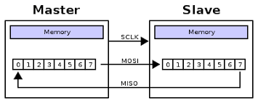

Slide 16
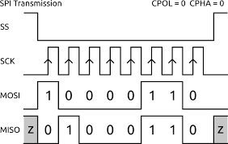

Slide 17
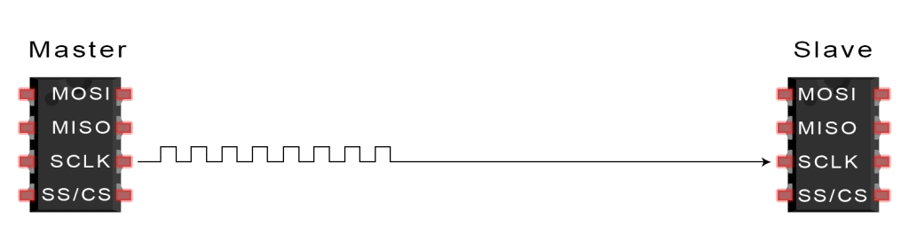
Steps
The master outputs the clock signal:

Slide 18
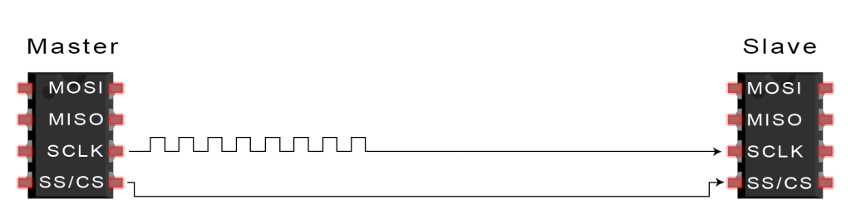
The master switches the SS/CS pin to a low voltage state, which activates the slave:

Slide 19
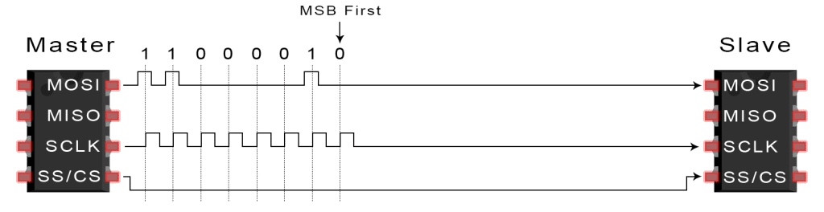
The master sends the data one bit at a time to the slave along the MOSI line. The slave reads the bits as they are received.

Slide 20
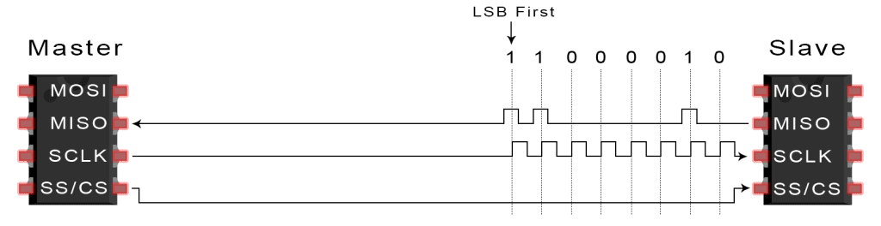
If a response is needed, the slave returns data one bit at a time to the master along the MISO line. The master reads the bits as they are received.

Slide 21
ADVANTAGES
No start and stop bits, so the data can be streamed continuously without interruption
No complicated slave addressing system like I2C
Higher data transfer rate than I2C (almost twice as fast)
Separate MISO and MOSI lines, so data can be sent and received at the same time(Full duplex).

Slide 22
DISADVANTAGES
Uses four wires (I2C and UARTs use two)
No acknowledgement that the data has been successfully received (I2C has this)
No form of error checking like the parity bit in UART
Only allows for a single master

Slide 23
The end

